Slide 1


Covid-19 clearance web service using Microsoft azure
Cloud computing
Under the guidance of Prof. Eicke Godehardt
Group 20
Darshankumar Bapodariya 1340125
Mehjabeen 1377473
Priyank Dudhat 1340222
Rahul Kidecha 1340109

Slide 2


content
Introduction
Overview of Azure Cloud and Applications
Azure Cloud Architecture
What Is DevOps
DevOps lifecycle
CI, CD
System Architecture
Our web service
Conclusion
Reference

Slide 3
introduction
Aim to build a covid test clearance web service using DevOps.
Covid result uploaded by only registered laboratories.
Report is viewable at user side.
No need to carry hard copy of report.
Data will be stored on Azure cloud service.
Easy to maintain and track data.
Reduce the paperwork.

Slide 4
Azure Cloud and Applications
Most popular public cloud service platform.
Utilizing Microsoft’s cloud-based data centers.
Provides a variety of service in many sectors.
Applications:
App Development
App Hosting
Software Testing
Virtual Machine Creation
Virtual High Drives
Integration and Synchronization
Business Intelligence

Slide 5
Azure Cloud architecture
IaaS (Infrastructure-as-a-Service):
Highly scalable and automated.
Fully self-service for accessing and monitoring.
Allows businesses to purchase resources on-demand and as-needed.
PaaS (Platform-as-a-Service):
Provides a platform for software creation.
This platform is delivered via the web.
Accessible by multiple users.
SaaS (Software-as-a-Service):
Hosted on a remote server, accessible over the internet.
User not responsible for hardware or software updates.
Managed from a central location.
Source : https://www.bmc.com/blogs/saas-vs-paas-vs-iaas-whats-the-difference-and-how-to-choose/

Slide 6
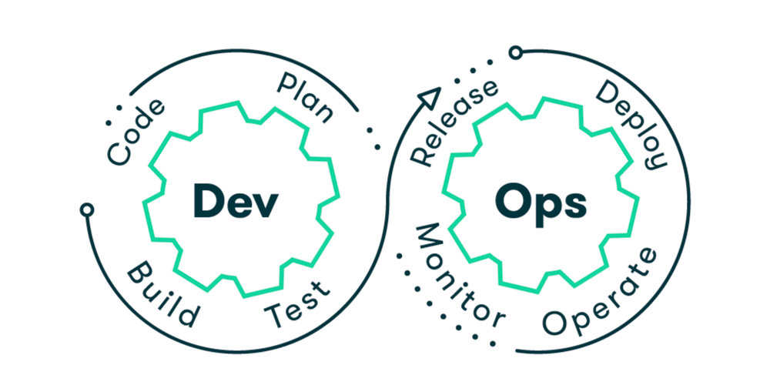
What is devops?
Method to bridging the gap between development and operations teams.
Aims to shorten the systems development cycle and provide continuous delivery with high software quality.
Emphasizes rapid delivery, continuous testing, and constant customers input, as well as the ability to react to change more quickly.

Slide 7
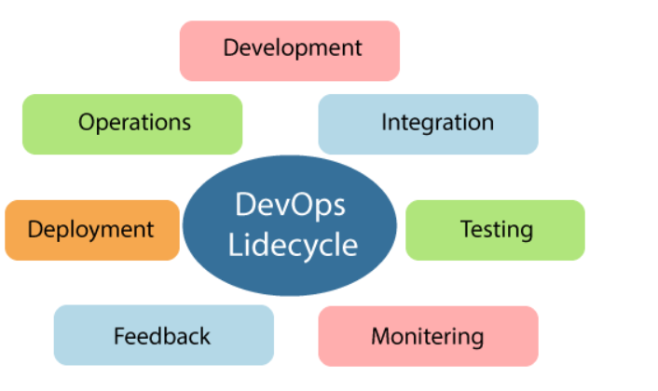
DEVOPS Lifecycle
Source: https://www.javatpoint.com/devops-lifecycle

Slide 8
Azure devops
Set of collaborative development tools build for the cloud.
Provides end to end chain tools.
Services:
Azure Test Plans:
Azure Boards: allows to plan, monitor and activities.
Azure Repos: gives unlimited Git repositories and provide advance file management service.
Azure Pipeline: automates building and testing of code.
Comprises a CI/CD pipeline.
Provide support in GitHub integration, multiple target deployment.
Support numerous languages and platforms
Azure Artifacts: allows to share code with others.
Source:
https://intercept.cloud/en/news/what-is-azure-devops/
https://www.javatpoint.com/azure-devops

Slide 9
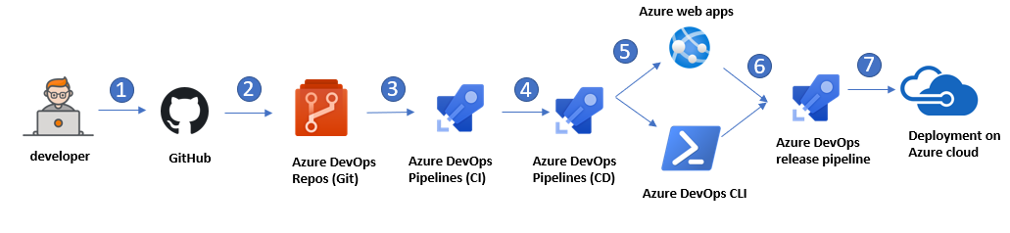
SYSTEM ARCHITECTURE
1
A Developer build the source code of the Application. Devlopers commit the source code into GitHub.
2
The application code is submitted in the source code repository in Azure Repos via GitHub.
3
Continuous integration (CI) triggers the application build process and unit tests with Azure Test Plans.
4
Continuous deployment (CD) in Azure Pipelines triggers automated deployment of application artifacts with environment-specific configuration values. The artifacts are provided in Azure App Service.
5
Azure Application Insights collects and analyzes health, performance, and usage data.
6
Azure DevOps release pipeline which we have created after CI/CD process.
7
Finally, we deploy our web service to Azure cloud after release the pipelines

Slide 10
Covid-19 clearance web app
This web service aims to solve current covid-19 clearance problem at shopping centres, barber’s shop, airport etc.
They all need covid-19 negative report of the person to enter in shop. So, for that we all need to keep covid report with us to get entry.
For that we have built a web service where only authorized laboratories can upload Covid result of victim to the server so, shoppers can directly check the covid-19 report by our web service. Also, we have deployed our web service on cloud platform.

Slide 11
conclusion
We worked on Azure DevOps services, features followed by a comprehensive set of instructions for deploying apps across various cloud services and settings as part of this project.
Our primary goal is to use this IaaS platform to deploy apps in a variety of settings.
Future work
we will work on adding one more feature, adding the database of vaccinated people, in this application. This feature will help us to check either the person is already vaccinated or not.

Slide 12
Thank you

